Slide 1

Auditing our Deps
Notes:
Welcome to my ted talk
Dependency management
Focus on node
Look at some primers

Slide 2

Primers
Notes:
Covering off somethings everyone already knows

Slide 3
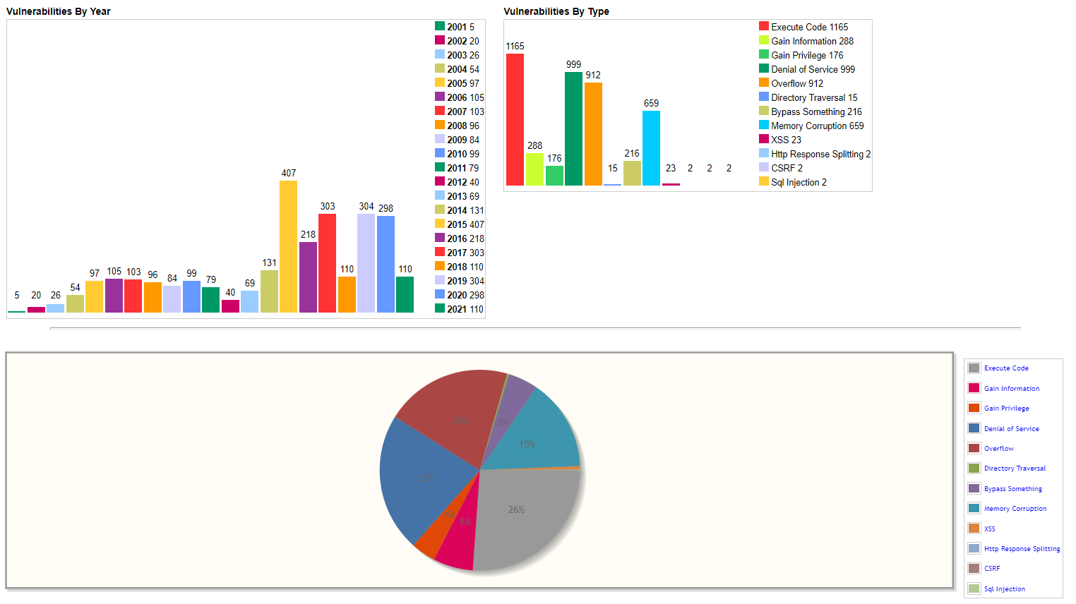
Common Vulnerabilities and Exposures
MAC OS X
Notes:
Cves
Apply to all types software library, Telsa car, operating system
Scoring – sev rating – moderate / high use open standard
Based off how easy/hard/impact
Describe outlook exploit

Slide 4
Assessing CVEs
Is it user facing?
E.g. Regexing user input
Storing user data in a database
Not user facing
Bundling (Webpack, esbuild)
Tooling/CI
`trim-newlines` has an issue related to regular expression denial-of-service (ReDoS) for the .end() method.

Slide 5
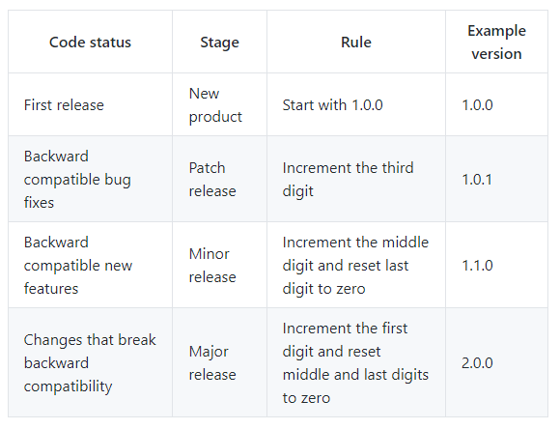
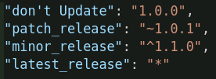
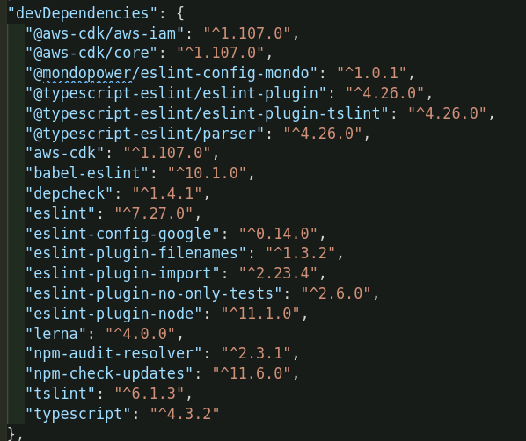
Semantic Versioning (SemVer)

Slide 6
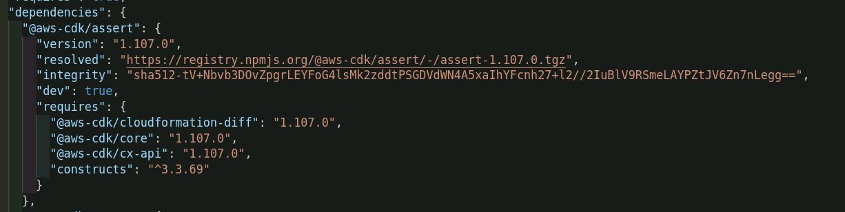
Package-lock
Package-lock -> Speeds up installs and ensures project security
Stores meta data about the packages
Stores hashes of packages
Notes:
Is generated by running an npm install
Resolve/intetergiy
Depedencies
Possible attacks

Slide 7
Npm install
NPM install -> Installs versions based off the package.json
NPM CI -> Installs based off the package-lock.json

Slide 8
Npm update / NCU
Npm update -> Updates to the latest version respecting semantic versioning
NCU -> Updates to the latest version ignoring semver
Npm run Ncu –u (updates everything)

Slide 9
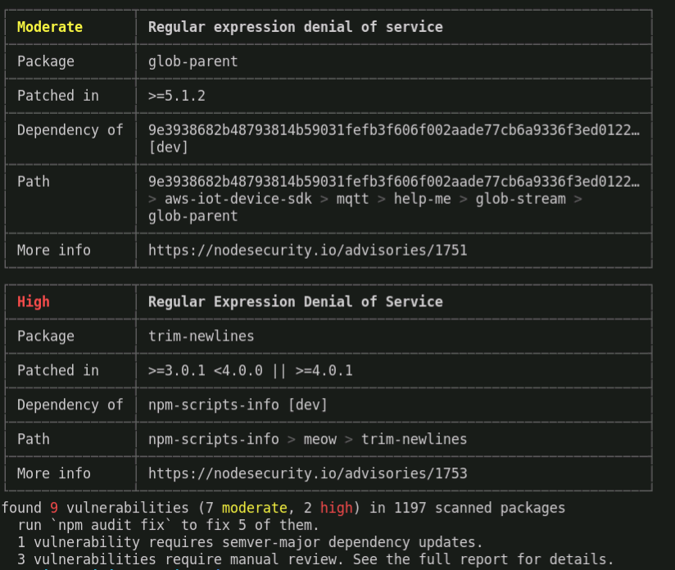
Npm audit
Ouputs a list of all vulnerabilities with some meta data

Slide 10
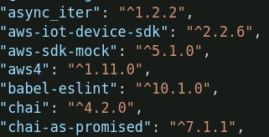
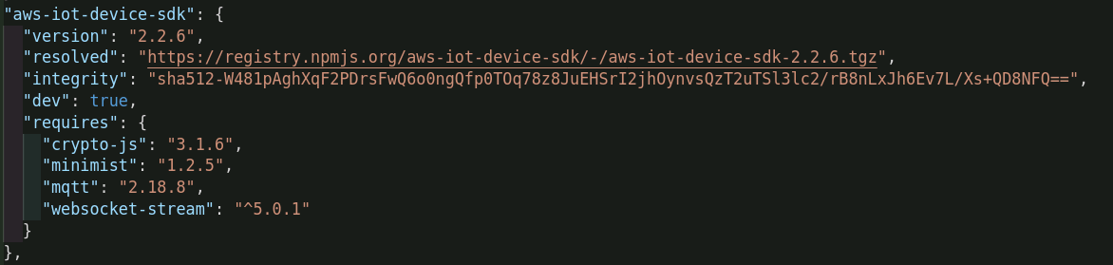
Npm audit fix
Checks if it can update the packages per semver
Checks if it can update the dependencies per semver
Notes:
Updates package json file – looks at ^
It can also go into the dependencies and look at the ^

Slide 11
Npm audit fix --force
Ignores semantic versioning
Updates top level dependencies to latest version that fixes CVE (package json)
Updates second level dependencies to latest version that fixes CVE (package-lock)
Don’t do this unless you absolutely have to

Slide 12
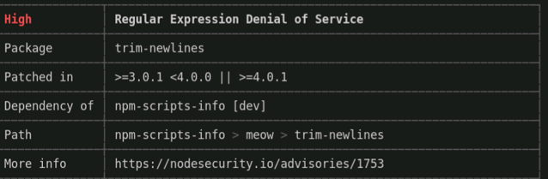
Npm-force-resolutions
Allows you force update nested dependencies
Don’t do this unless you absolutely have to
"resolutions": { “trim-newlines": "4.2.1"}

Slide 13
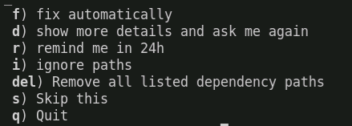
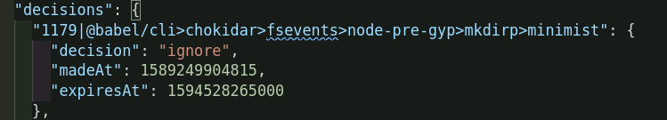
NPM Audit resolver
Allows us to ignore/Fix vulnerabilities
Commands:
Check-audit -> Compares npm audit output to audit-resolve.json
Resolve-audit -> Goes through each unresolved cve and allows you to ignore them
Notes:
We don’t use npm audit in ci
Is a wrapper for npm audit
Package x has an issue and it’s in audit resolver it will be ignored
We don’t use fix vulnerabilities

Slide 14
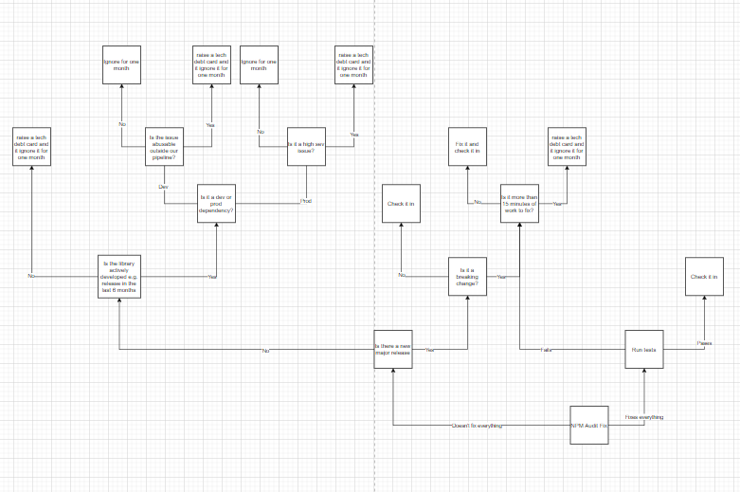
Audit workflow
Really big and clunky!
Notes:
I thought I’d have an open discussion about what it looks like
Do a little bit of a demo
I’m going to go through some scenarios and outcomes
This should translate into a formal process

Slide 15
Assess the situation
Questions:
Is it fixed by npm audit fix?
Is it a high priority user facing issue? Code execution browser bug?
Is it likely to be fixed soon? (Is the repo actively being worked on)
Is there an update but it’s a breaking change?
Outcomes:
Npm audit fix passes + test push to main
Add card to the board
Ignore the CVE for 2-4 weeks
Apply the breaking change and fix the code
Notes:
First scenario fixed by npm audit
Respected semver
We’ve run units and they’ve passed so we push to main
Scenario Two – isn’t fixed by npm audit fix and isn’t user facing
Scenario Three – Breaking change
Scenario Four – I’m not sure? Reach out to the team or add a card to discuss security is important not being sure is completely natural! And okay. It’s better to call it out

Slide 16
Demo!

